Slide 1
Cryptolocker Trojan
By Rahul Tailor

Slide 2
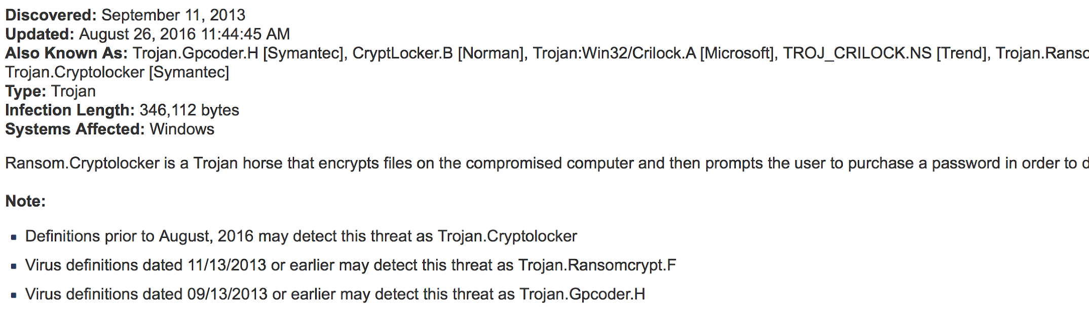
Overview
Cryptolocker is a malware threat that gained notoriety over the last years. It is a Trojan horse that infects your computer and then searches for files to encrypt. This includes anything on your hard drives and all connected media, for example, USB memory sticks or any shared network drives.

Slide 3
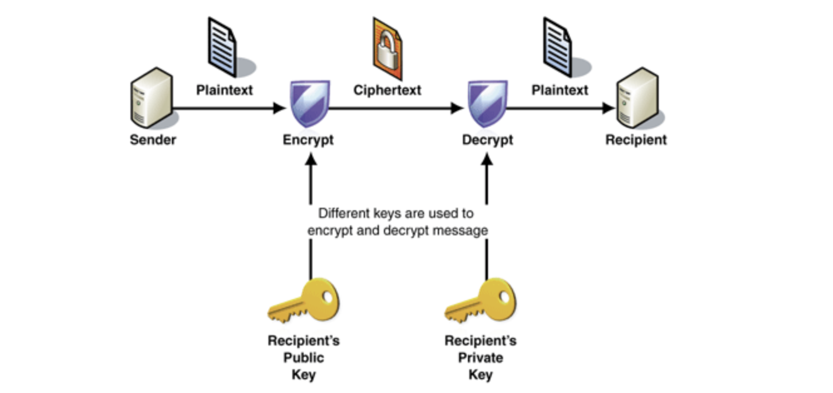
Interesting Facts
Files targeted are those commonly found: 3fr, accdb, ai, arw, bay, cdr, cer, cr2, crt, crw, dbf, dcr, der, dng, doc, docm, docx, dwg, dxf, dxg, eps, erf, indd, jpe, jpg, kdc, mdb, mdf, mef, mrw, nef, nrw, odb, odm, odp, ods, odt, orf, p12, p7b, p7c, pdd, pef, pem, pfx, ppt, pptm, pptx, psd, pst, ptx, r3d, raf, raw, rtf, rw2, rwl, srf, srw, wb2, wpd, wps, xlk, xls, xlsb, xlsm, xlsx
infected users are instructed to pay $300 USD to receive this private key.

Slide 4
Targets
Education
Mostly in file sharing among the your group.
Government
Personal Information
Healthcare, energy/utilities, retail, finance
Mostly hospitals where patient data is critical in life-or-death situations.
Human Resource Departments
They get emails from there clients but when they open the email it is not legit.
Mobile devices and Mac
Windows computers when there security is not actually secured properly and your computer can get a virus.

Slide 5
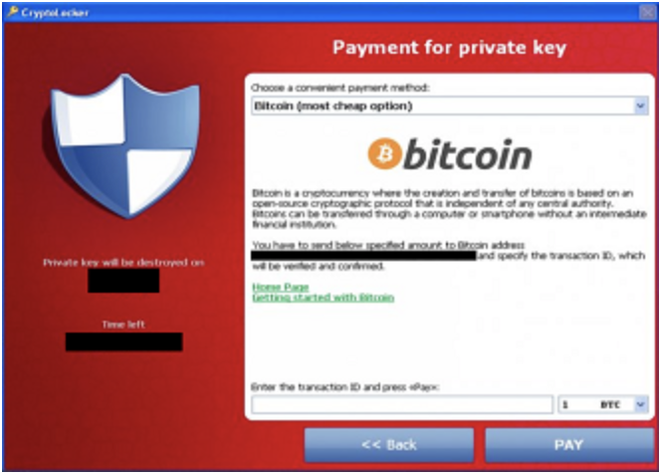
What it did?
It infected email attachments to spread across the Internet, infect Windows PCs, and lock files using RSA 2048 bit encryption.
The trojan encrypted files stored on local or mounted network drives. Since it wasn’t a virus, it didn’t spread across your network on its own. However, it was still capable of doing a lot of damage, because it searched your network extensively, looking for files to encrypt.

